Slide 1
COMSCORE
Competitive Analysis and Marketing Strategy
Mattie Elkin and Jailyn Murphy

Slide 2
01
COMSCORE MARKETING ANALYSIS
Understanding ComScore's market position and offerings is crucial for analyzing its competitors. This slide will delve into ComScore's key strengths, weaknesses, opportunities, and threats (SWOT analysis).

Slide 3
SWOT
STRENGTHS
WEAKNESSES
Diverse Offerings
Solution Oriented
Proximic AI
Market Competition
Ease of use
Brand/ category set-up
OPPORTUNITIES
THREATS
AI and Machine Learning Integration
Partnerships
Emerging Competition
Data Privacy Regulations

Slide 4
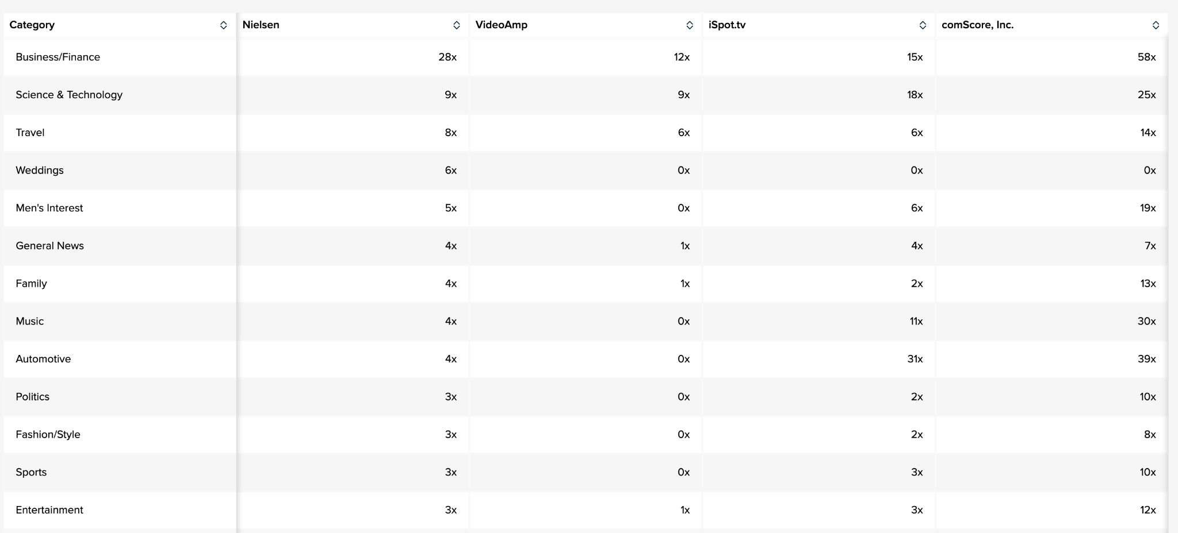
Interests
Business/ Finance (ComScore- 58x)
Science and Technology (ComScore 25x)
Travel (ComScore 14x)
Leverage movies

Slide 5
02
COMSCORE COMPETITORS
BACKGROUND

Slide 6
SWOT (ALL COMPETITORS)
STRENGTHS
WEAKNESSES
Heavy visuals
Audience Design
Agency Analytics/ Measurements
Market Optimization
Outcome Measurement
Heavy focus of TV measurement
Segmented by use case
OPPORTUNITIES
THREATS
Solution oriented
AI
Competition
Data Privacy Regulations

Slide 7
VideoAmp
Measurement & Optimization for Data-Driven Advertising
Solutions for Agencies, Brands, and Publishers
Agencies
Measure the entire customer journey and optimize channel and partner mix with one unified platform
Brands
Increase return on ad spend and make measurement actionable with data-driven recommendations.
Publishers
Maximize inventory value and accurately measure impressions with a currency-grade datasets

Slide 8
iSpot
Overview
iSpot.tv helps advertisers measure the brand and business impact of TV and streaming advertising, from concept to airing to conversion.
purpose-built to measure the performance of every ad on television with digital-like precision and granularity in real time
Brands,networks, agencies
Brands
Test video ads with a Survey-based creative assessment
Networks
Prove and Optimize the Value of Linear and Streaming Inventory
Agencies
Cross-platform TV and video ad measurement

Slide 9
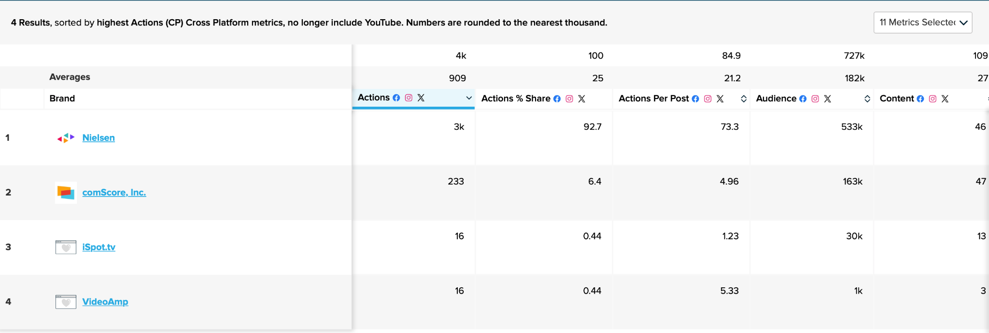
Nielsen
ComScore’s biggest Competitor- not segmented by group but by features (solution oriented)
Audience Measurement
Media Planning
Marketing Optimization
Gracenote content metadata

Slide 10
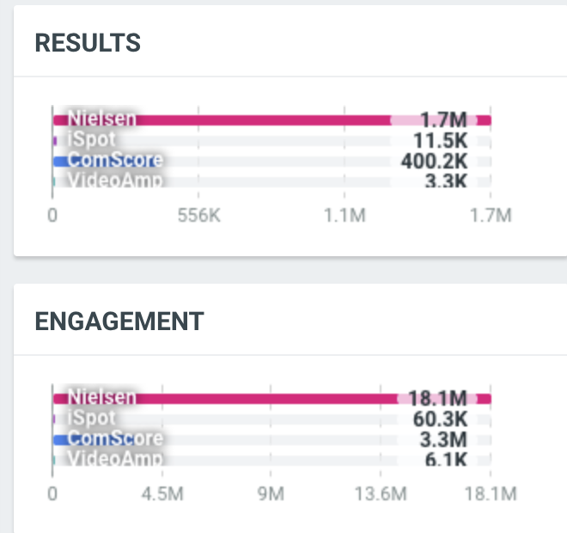
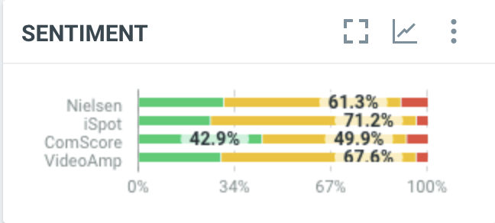
Metrics
Nielsen is ComScore’s biggest competitor
More results and engagement
ComScore has high positive sentiment
Nielsen is good at marketing their product
ComScore’s sentiment shows that customers respond positively to their brand image
However ComScore struggles to promote engagement

Slide 11
03
NIELSEN CHANNEL ANALYSIS
Competitor analysis on ComScore’s biggest competitor: Nielsen

Slide 12
Key Metrics (Nielsen) - 30 days
Followers: 322,525
Posts: 16
Actions: 632
Unique Engaged Audience: 291
Impressions: 200,240
Followers: 193,292
Posts: 12
Actions: 887
Unique Engaged Audience: 380
Followers: 17,248
Media: 5
Actions: 169
Videos: 1
Reference Appendix for more competitor key metrics (Slides 22 &23)

Slide 13
Nielsen vs ComScore Content
Nielsen
Top Ten
Presentation is easy to understand and concise
Logos
Data is able to be digested and used by the consumer
No need to go online for further information
Provides suggestions to customer’s daily activities (i.e. watch this)
Listed as a “Media”
ComScore
Screen grabs from comscore platform
Blog Posts- difficult to get engagement and clicks
Often links
Listed as “Internet Company”

Slide 14
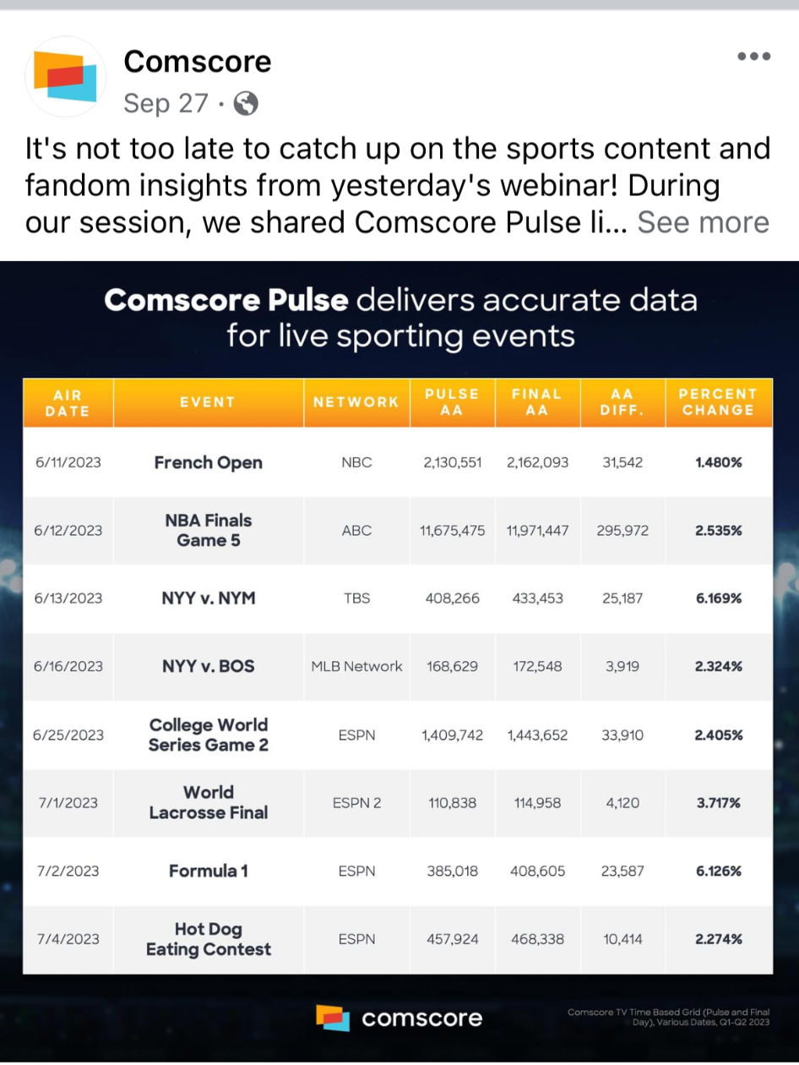
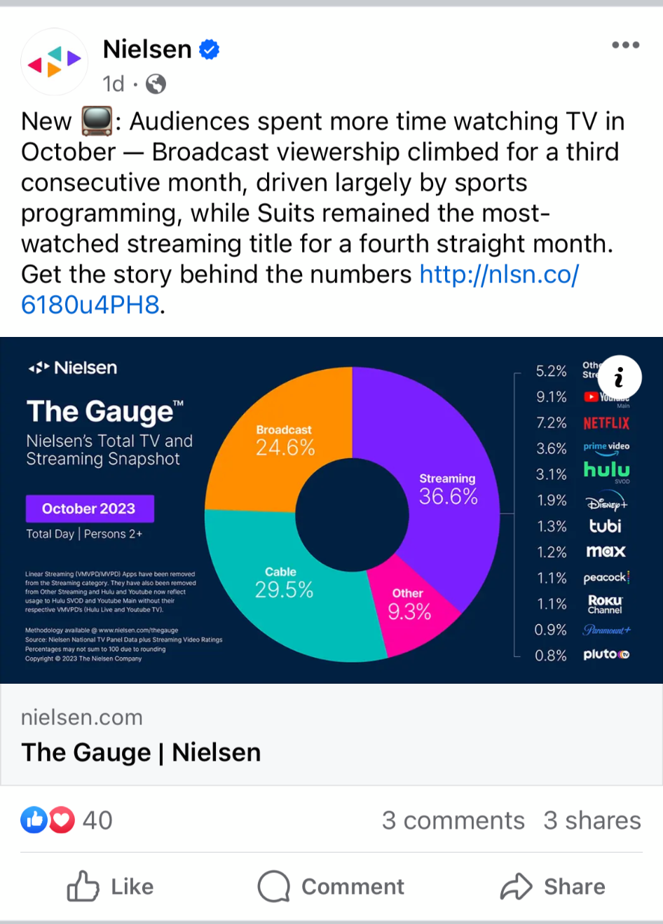
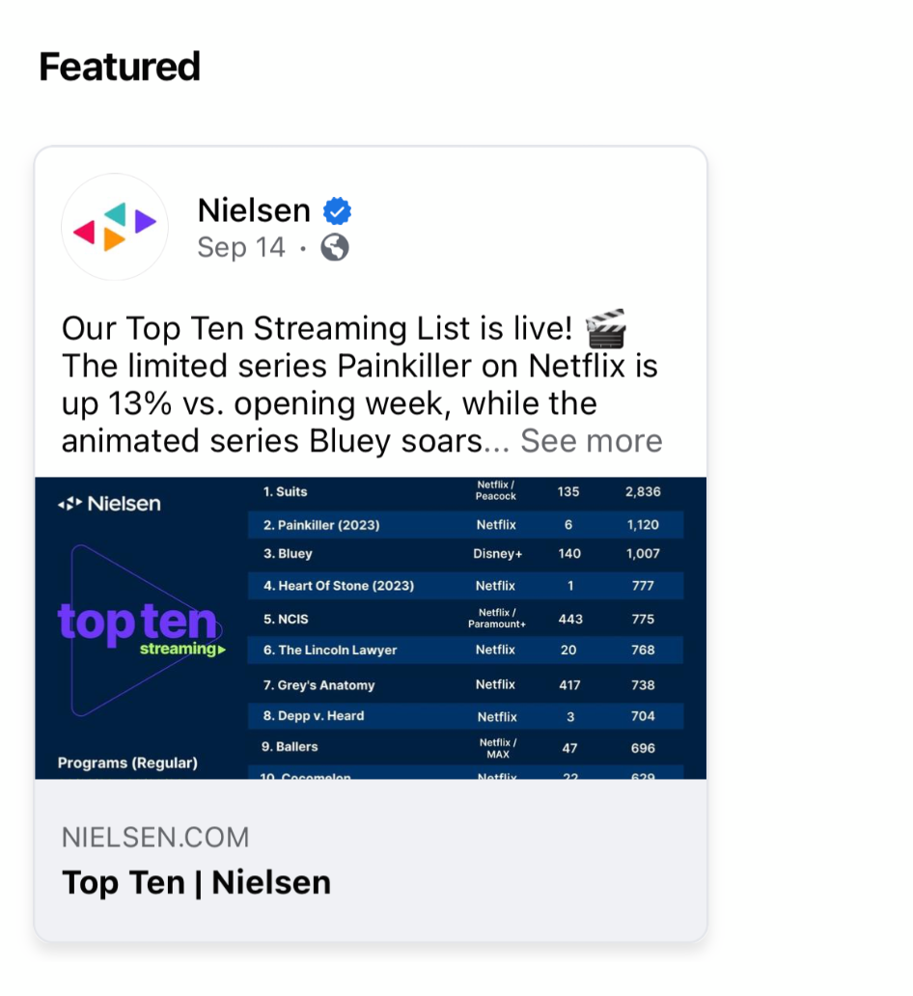
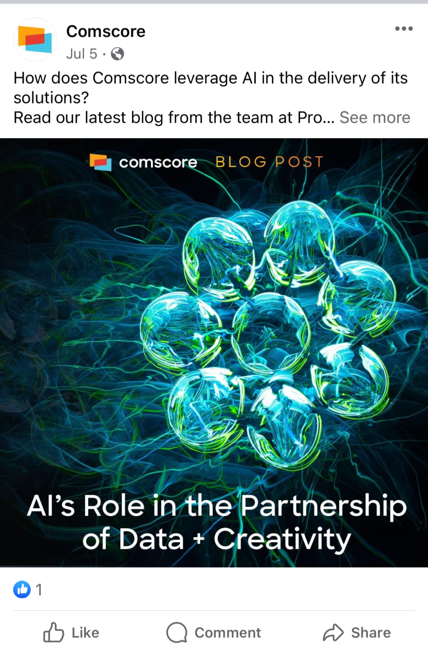
Facebook Examples

Slide 15
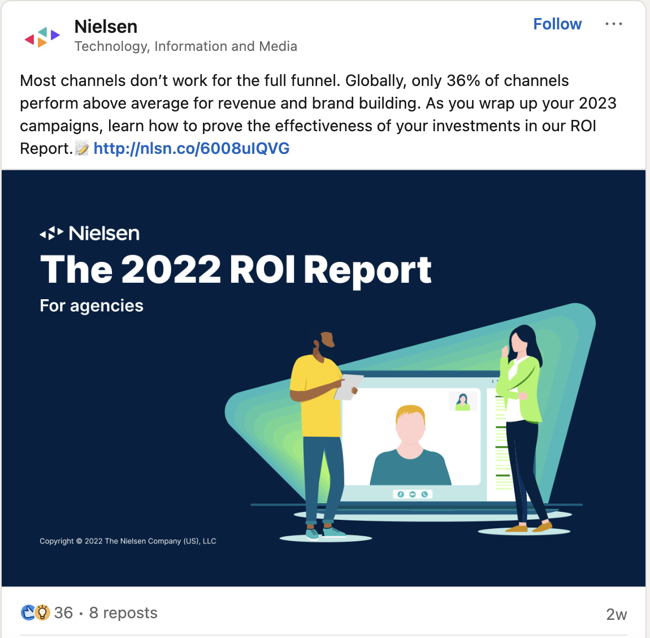
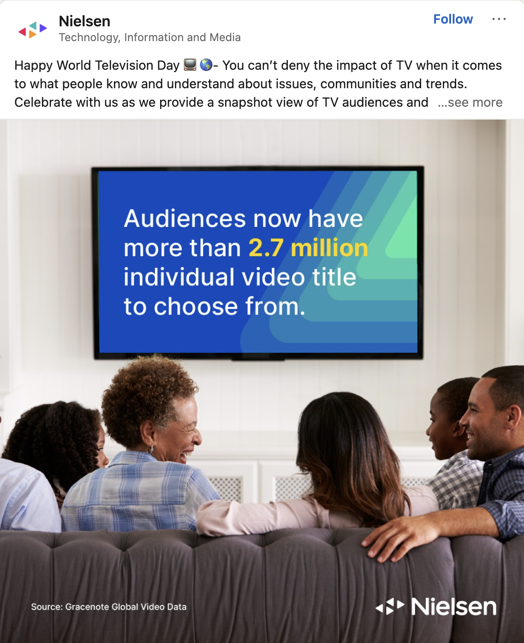
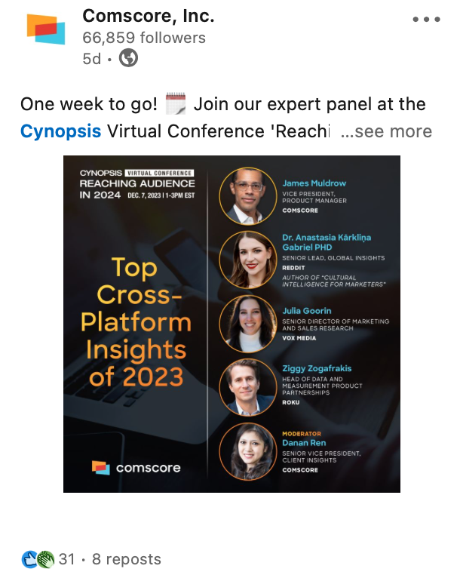
Linkedin Examples

Slide 16
04
COMSCORE MARKETING STRATEGY

Slide 17
ComScore Channels - 30 Days
Followers: 33,040
Posts: 8
Actions: 19
Unique Engaged Audience: 4
Impressions: 4,017
Followers: 129,600
Posts: 12
Actions: 49
Unique Engaged Audience: 40
Followers: 980
Media: 16
Actions: 152
Videos: 2

Slide 18
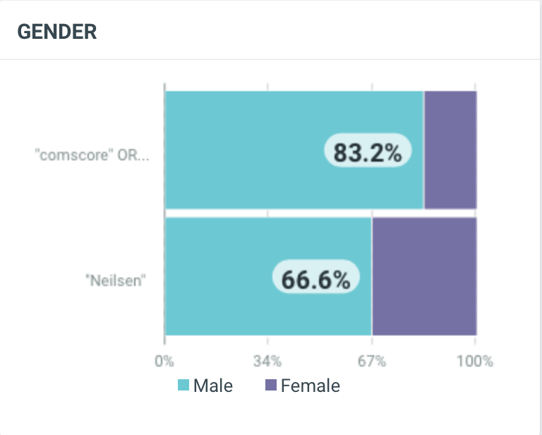
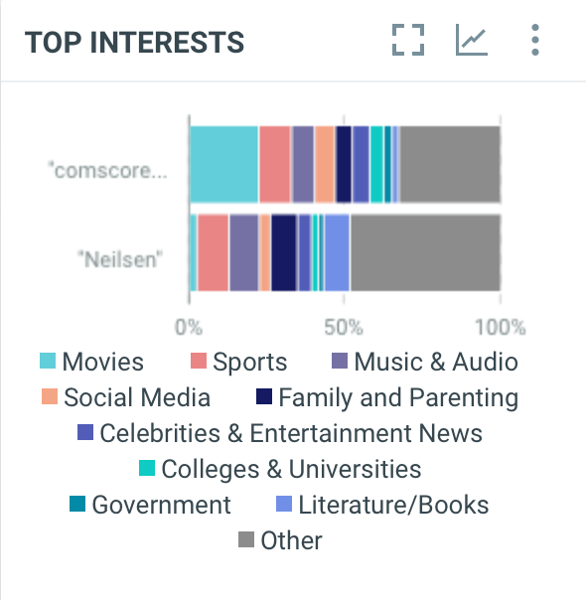
Demographics

Slide 19
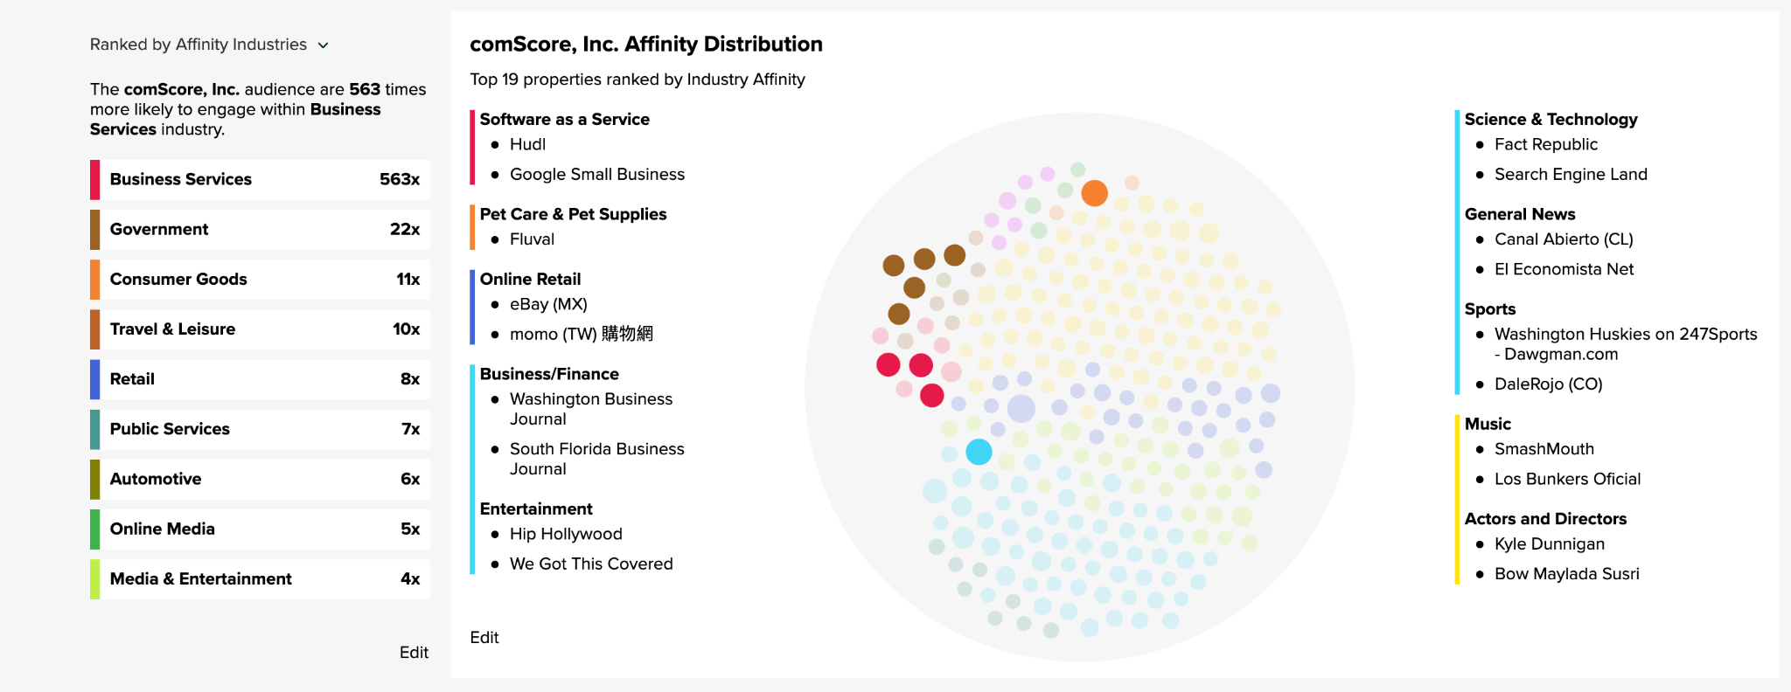
ComScore Affinity Groups
Business Services
Software
Online retail
Pet care
Nielsen’s affinity groups are more oriented with sports and entertainment
Nielsen affinity group’s located in Appendix (slide 24)

Slide 20
SMART
Specific
Focus on Facebook and Linkedin
More personable
Possibly make connections with larger businesses
Promote TV/Video services
Increase market optimization and outcome measurement
Optimize affinity content
Advertise to women in business
Simplify data in posts
Explore other Category Titles on Facebook
Measureable
Engagement
Conversion rate
Affinity group expansion (larger businesses/partnerships)
Increase in gender demographic
Improve SEO

Slide 21
SMART cont.
Achievable
Already on platform (Facebook and Linkedin), just expanding and advertising better, providing free reports
Competitors are making connections with larger businesses already
Promoting and advertising already existing products
Adjust and improve accessibility services that already exist
Promoting movie interests
Relevant
Improves:
Affinity groups
Engagement
Demographics
Sentiment
SEO
Time-bound
Push out on Holidays and large TV/movie events
Continue to cover sporting events in real time
Reevaluation of KPI’s every 3 months

Slide 22
APPENDIX

Slide 23
Key Metrics (VideoAmp)
n/a
Followers: 1,263
Posts: 2
Actions: 10
Unique Engaged Audience: 6
n/a
n/a

Slide 24
Key Metrics (iSpot)
Followers: 24,405
Posts: 11
Actions: 19
Unique Engaged Audience: 14
Impressions: 6,991
Followers: 4,194
Posts: 7
Actions: 6
Unique Engaged Audience: 4
Followers: 1,105
Media: 0
Actions: 0
Videos: 1

Slide 25
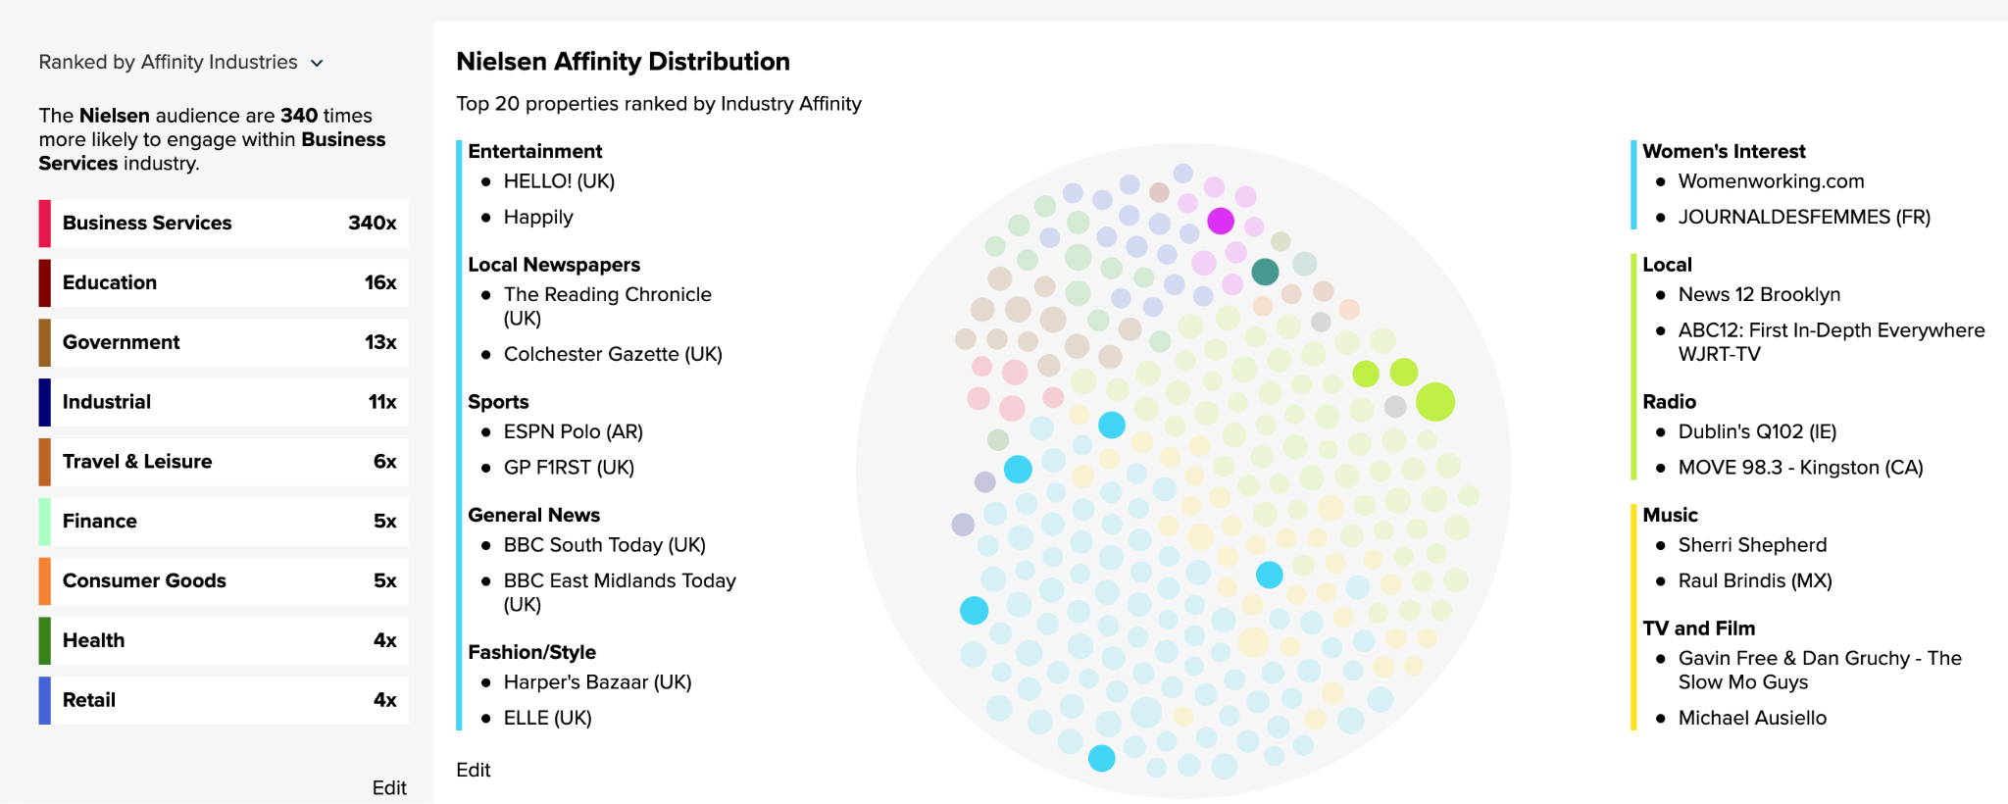
Nielsen Affinity Groups

Slide 26
References

Slide 27
Nielsen Website: https://www.nielsen.com/solutions/
ComScore Website: https://www.comscore.com/About
Ispot.tv website:https://www.ispot.tv/
VideoAmp Website: https://videoamp.com/
ComScore: https://core.comscore.com/v2/home
ComScore Facebook: https://www.facebook.com/comscoreinc
Nielsen Facebook: https://www.facebook.com/Nielsen
Talkwalker Website: https://www.talkwalker.com/

